Slide 1





The 100 Retirement Estate Project
A Self-Sufficient Retirement Estate for the Diaspora
A member-funded vision for a secure, vibrant, and sustainable retirement in Zimbabwe.
100 Homes
55ha Macadamia Orchard
100% Off-Grid

Slide 2




Strategic Investment Structure
UK-Based Legal Foundation
Escrow Management
Begins as a UK Private Limited Company or SPV for legal clarity. A zimbabwean subsidiary owned by the UK company.
Funds held in company account which requires multiple signatories until targets are met
Strict Membership Cap
Land Acquisition Target
Limited to 100 Members to keep the group focused.
Execution in Zimbabwe once collective funds reach ≈ $100,000-$200 000.
Equity Allocation
Transparent Auditing
Contributions convert into equal Equity Units among members.
Regular financial reports to all members during accumulation.

Slide 3



Three-Tier Governance Model
UK Board
Zim Project Manager
The Constitution
Manages funds, audits, and UK tax compliance. Ensures financial transparency for all diaspora investors.
Registered firms (e.g., Knight Frank) handle local permits, RDC zoning, and professional construction oversight.
Legally binding document: land title held by the Company. All 100 residents are equal shareholders.
Investor Protection: This structure eliminates "project drift" and ensures no single individual can sell or mismanage communal land.

Slide 4


Financial Phasing & Milestones
Stage 1
Stage 2
Stage 3
Stage 4
Accumulation
Acquisition
Infrastructure
Construction
£100,000 - £200 000
£50,000 - £100 000
Individual/Levy
Register UK company and open company accounts
Full purchase of land in Zimbabwe only after legal due diligence . Only land with title deeds
Perimeter fencing and 5x Boreholes.
Individual homes built to agreed plans.
Members deposit their first payments until agreed sum is reached..
First 55ha of Macadamia planting.
Clubhouse, Pools, and Clinic completion.
Allocation of stands and servicing
Each stage is triggered only upon reaching the collective funding target, ensuring financial security.

Slide 5

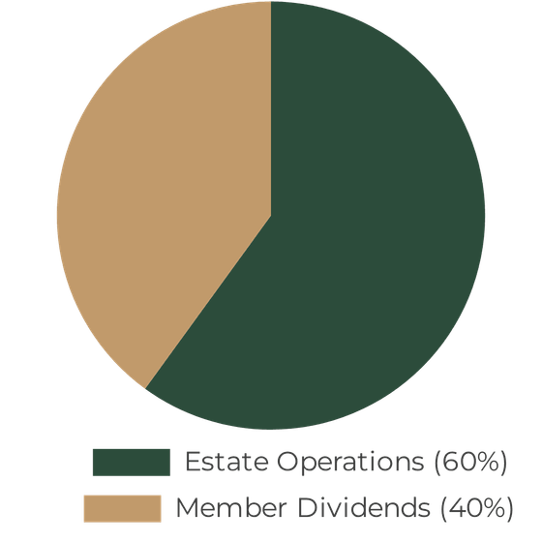


The "Zero-Levy" Revenue Model
$400,000+ USD
PROJECTED ANNUAL GROSS REVENUE
55 Hectares
COMMERCIAL MACADAMIA ORCHARD
60% Allocation: Covers Security, Medical Staff, and Utilities.
40% Allocation: Paid as a "Retirement Dividend" to members.
Sustainable model eliminates traditional monthly levies.
Annual Profit Distribution Strategy

Slide 6



Off-Grid Sovereignty
Energy Independence
Water Security
Waste Management
Every home is built with integrated solar roofs. No ZESA dependence, no load-shedding, and zero monthly power bills.
5–7 dedicated on-site boreholes ensure a constant, reliable water supply for both domestic use and the macadamia orchard.
A central biodigester system handles waste efficiently, contributing to the estate's self-sustaining ecosystem.
Total infrastructure autonomy from national grids ensures peace of mind and long-term sustainability for all residents.

Slide 7





Wellness and Lifestyle: The "Vibrancy" Perks
Wellness Core
15 Hectares
Heated 25m lap pool, 2 tennis courts, and 2 pickleball courts managed by on-site professional staff.
Wetlands & Nature Trails
Dedicated space for bird watching and morning walks, preserving Zimbabwe's incredible biodiversity and promoting mental wellness.
Social Hub
Boutique clubhouse featuring a gym, library, pub, and restaurant for daily social engagement.
On-Site Convenience
A dedicated local shops providing all daily necessities within walking distance of every home.

Slide 8








Comprehensive Healthcare and Security
Medical Care
Security Infrastructure
24/7 On-Site Clinic & Pharmacy
AI-Integrated Fencing
Dedicated nurse-led facility providing immediate medical attention and wellness monitoring for all residents.
Thermal perimeter fencing with AI motion detection and 24/7 monitoring for proactive threat identification.
Emergency Response
Vetted Security Team
On-site ambulance with 24/7 priority access to the nearest top-tier private hospitals in Harare or Bulawayo. Arrangements for medi vac to SA if needed.
Internal, highly-trained security personnel conducting regular patrols and managing access control.
Peace of Mind: A secure environment designed specifically for the unique needs of retirees, ensuring safety and rapid care at all times.

Slide 9

100-Hectare Master Plan Allocation
Feature
Land Use
Impact on Life
Macadamia Forest
55 ha
The estate's financial engine; provides shade, beauty, and revenue to eliminate monthly levies.
Solar-Ready Homes
20 ha
100 luxury retirement residences with integrated solar; zero power bills and total peace of mind.
Wetlands & Trails
15 ha
Preserved natural habitat for bird watching, morning walks, and mental wellness.
Utility Hub
5 ha
The "Brain" of the estate; housing boreholes and biodigester.
Clubhouse & Sports
5 ha
Social heart of the community; featuring the gym, library, pools, and tennis courts.
*Total Land Area: 100 Hectares. Designed for maximum self-sufficiency and resident vibrancy.

Slide 10

Next Steps: Moving to Reality
01
Legal Setup
Draft the SPV Articles of Association with clear exit strategies for members during the accumulation phase.
Join the Sanctuary Vision
02
Land Scouting
Secure your place in Zimbabwe's premier self-sufficient retirement community.
Appoint a trusted representative to identify 100ha plots
03
Member Recruitment
Finalize the 100 founding members to trigger the Stage 1 accumulation phase immediately.
Timeline: Immediate Commencement

